Slide 1

Lesson overview – What do you need to do to complete this lesson?
Area of learning: Product Design Year 7 – Lesson 14
Activity time: 1 hour
Resources, equipment, links needed to complete the work:
Year 7 Product Design booklet, a pencil, pen, computer / chromebook
Success Criteria. What are you going to do?
All: Will begin to navigate 2D Design – introducing themselves to the program
Most: Will complete the worksheet to label the 2D Design tools
Homework:

Slide 2
Learning Objectives
I can describe what CAD is
I can list different functions of a CAD program
I can describe features on 2D design

Slide 3
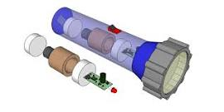
What is CAD
Computer Aided Design (CAD) is a vital tool for a Product Designer. CAD software allows a designer to quickly produce 3D images/designs. The design can then be rotated, colour rendered and analysed/evaluated. Then it can be improved. Software such as SketchUp, provided by Google, is ideal for a young designer or a professional. In school we use TinkerCAD and 2D design.

Slide 4
Advantages of CAD
1. The drawing can be rotated to any angle by using the mouse.
2. It is possible to zoom in and out of the drawing, magnifying areas so that they can be seen easily.
3. Mistakes can be corrected easily and alterations made, often with just a click of the mouse.
4. Colours and textures can be applied and changed at will.
5. Final drawings can be exported as photographic files (jpeg, png etc...) and used in word processed documents or PowerPoint presentations.
6. Multiple copies can be printed out, for clients / customers to view.
7. The final drawing/file can be emailed around the world in a matter of seconds.
8. Each component/part making up the drawing, can be examined individually, especially when the drawing has been ‘exploded’.
9. Unlike drawing by hand, a CAD drawing can be altered, improved, rotated or moved, without the need to redraw the entire product each time. 10. It is quick and simple to draw

Slide 5
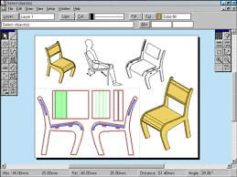
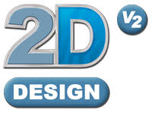
2D Design V2
2D design is a CAD program that allows the designers to draw 2D images. These can then be coloured, edited, improved…
The drawing can then be sent to a CAM machine and work printed, cut or engraved.

Slide 6
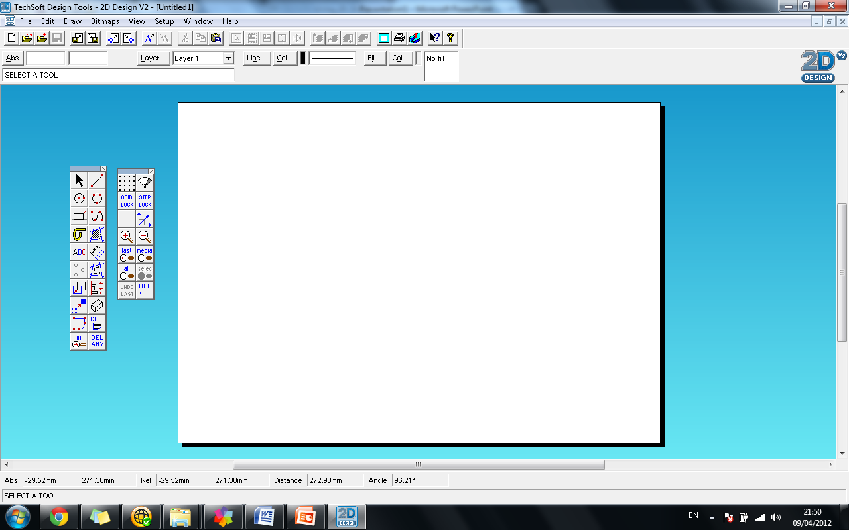
Task Name the tool…
Use 2D Design to find the names of the different tools
Hint – Hover your mouse over each function and it will reveal its name
Once you have found the names of the tools, try having a play to see what they do.

