Slide 1


How did people in the 20th century attempt to treat and cure illness and disease?
This is lesson 3 and is completing key question 3 from ‘Changes in Health and Medicine’ – Unit 3 – WJEC GCSE
This lesson will take 1 hour.
Bring a paper or notebook and a pen.
You will need to STOP and do some timed activities during the lesson.

Slide 2

Complete the sentences below with an accurate term
DO THIS NOW….PAUSE THE VIDEO
Write down the answer. This is the style of question 1 on the exam paper
In the 1840s, James Simpson pioneered the use of chloroform as
a _____________________________.
In the 1800s, many doctors tried to remove pain from ___________.
Joseph Lister improved the chances of surviving surgery by spraying the equipment with _____________________ .
Over time, doctors stopped wearing their own suits into
the operating theatres. They started wearing ___________ .

Slide 3

Complete the sentences below with an accurate term
Correct your answers. Did you get them all right? Do you need to go back to read over your notes?
In the 1840s, James Simpson pioneered the use of chloroform as
a _____________________________.
In the 1800s, many doctors tried to remove pain from surgery.
Joseph Lister improved the chances of surviving surgery by spraying the equipment with carbolic acid .
Over time, doctors stopped wearing their own suits into
the operating theatres. They started wearing aprons/gloves OR PPE.
Anaesthetic OR pain killer

Slide 4
During this lesson, we will…
Describe the work of Marie Curie.
Consider the importance of antibiotics.
Consider the progress that has been made in transplant surgery and cancer treatment.
Reflect on how attempts to treat and cure illness and disease have changed over time.
We will finish this lesson with 2 exam questions.

Slide 5
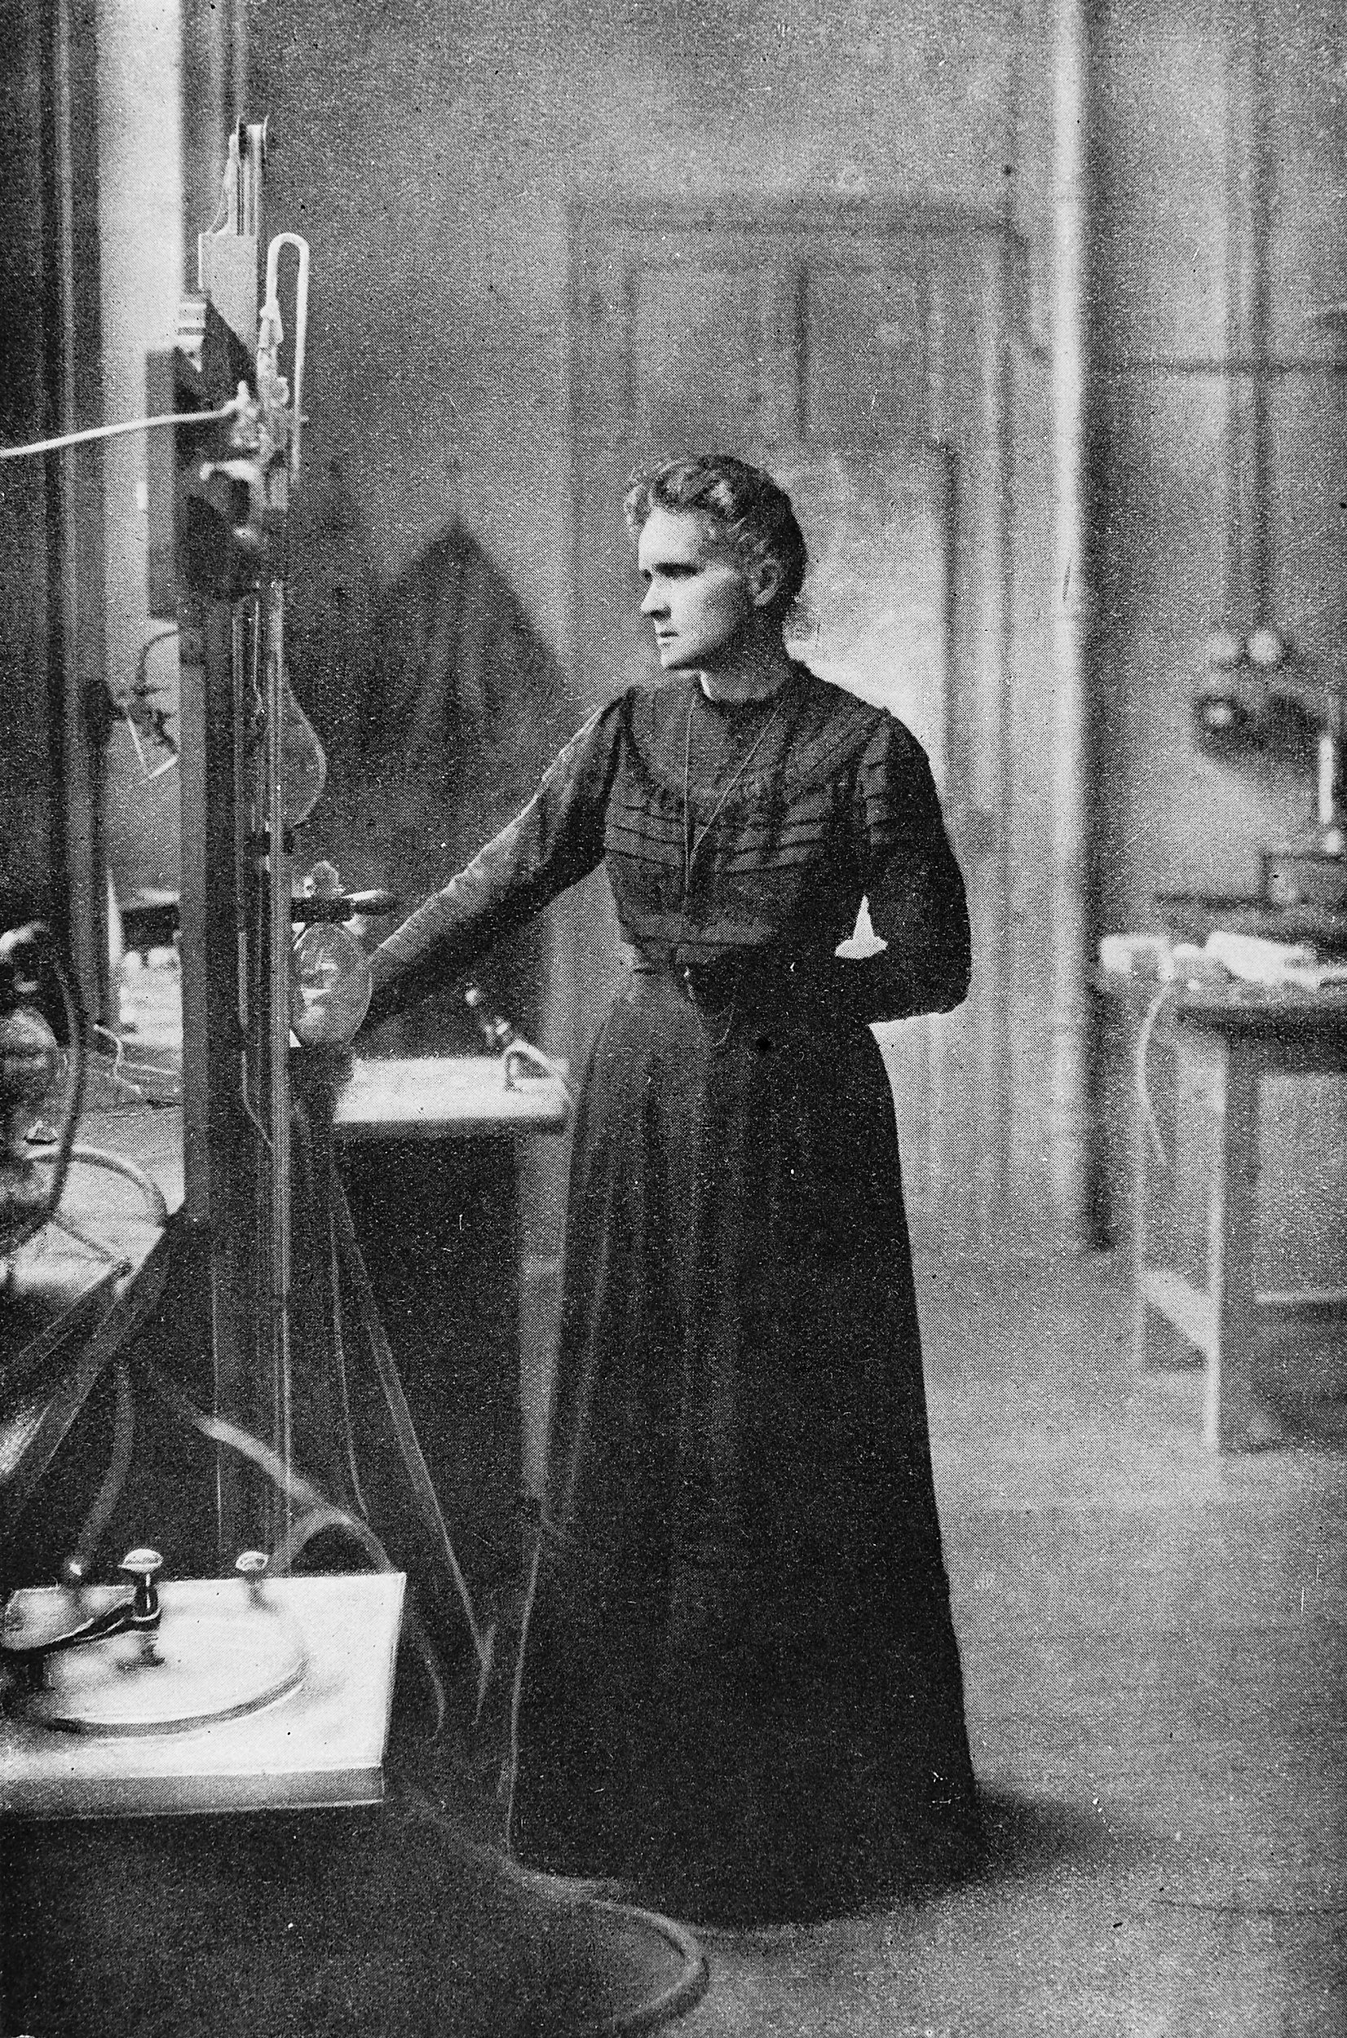
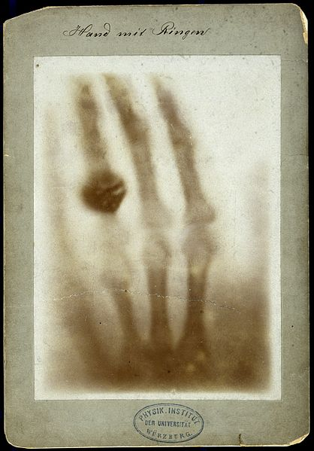
Describe the work of Marie Curie
First woman to win a Nobel Prize for science. She won twice!
Marie and her husband successfully isolated radioactive materials: radium and polonium.
She played a leading role in developing mobile x ray units during WWI.
Radium can be used to shrink
cancerous tumours.
Marie Curie's mobile x-ray units
X rays discovered by Wilhelm Rontgen in 1895

Slide 6
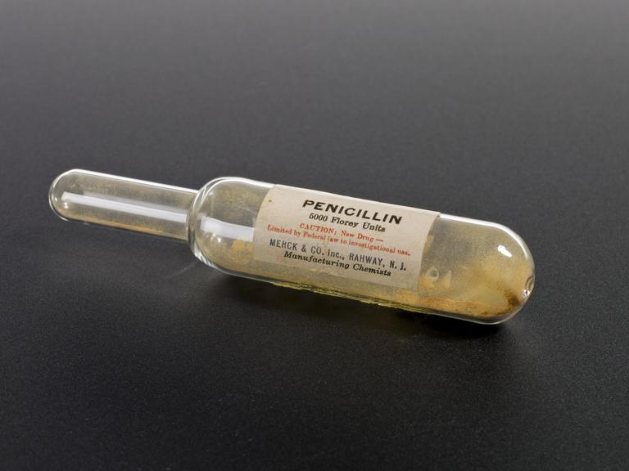
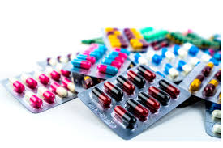
How important was the development of antibiotics?
19th century – penicillin had been discovered. This is an antibiotic.
Antibiotics are the most important type of antibacterial agent for fighting bacterial infections.
Antibiotic medications are widely used in the treatment and prevention of infections. They may either kill or inhibit the growth of bacteria.
In 2020 we know that…
Antibiotics ONLY treat certain infections caused by bacteria, such as:
Strep throat.
Whooping cough.
Urinary tract infection (UTI)

Slide 7
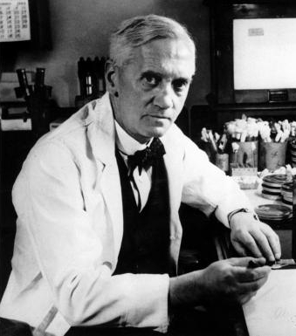
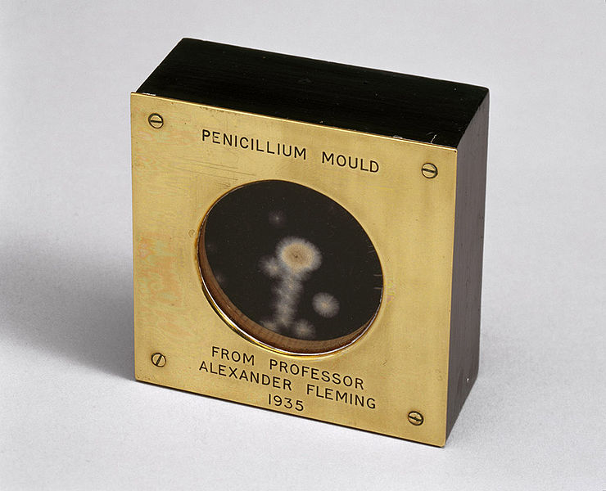
How were antibiotics developed?
Alexander Fleming searched for a solution to deep wound infections.
In 1928, he discovered a mould that had grown on a petri dish had killed the bacteria around it.
This mould was penicillin.
Penicillin is an antibiotic ‘destructive of life’
Although he published in 1929, the drug was not developed.

Slide 8
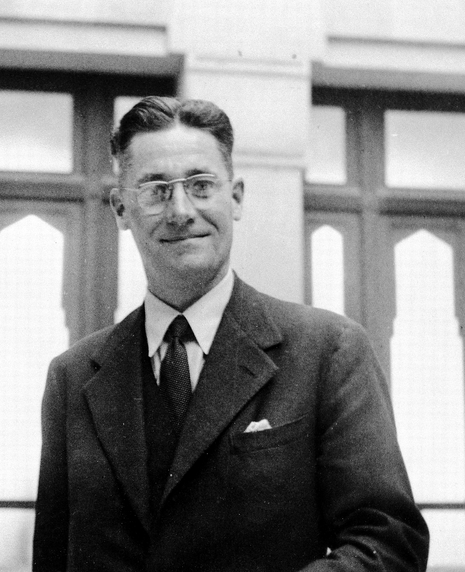
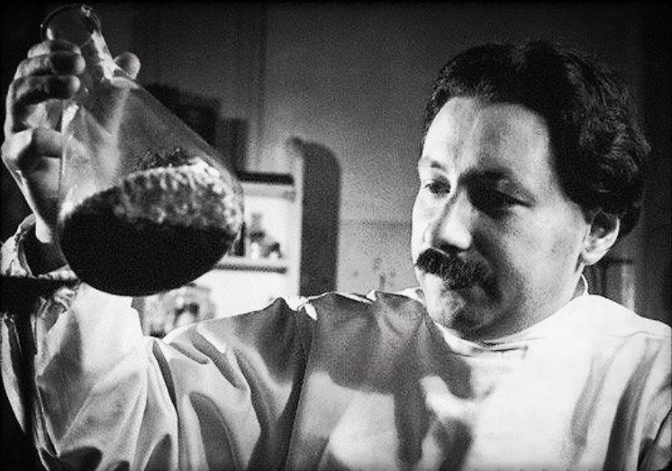
How did antibiotics become wonder drugs?
1937 Howard Florey and Ernst Chain, Oxford University, studied Fleming’s papers.
Discovered how to mass produce penicillin.
Experimented on mice and humans to prove how effective it was.
Shared the Nobel Prize for Medicine with Fleming in 1945.
In 1943, penicillin was rolled out to the allied troops during World War II.
Infection was a major wartime killer.
USA and UK worked to mass produce the drug.
After the war, it was used to treat many illnesses such as tonsillitis, abscess, bronchitis, impetigo.
Unfortunately, we have over-used antibiotics and in 2020 there is a push to reduce our usage.

Slide 9

Clip: Curie, Fleming, Florey and Chain
https://www.youtube.com/watch?v=my14ZuzjH5I
Watch this clip from BBC Teach for 4 minutes 50 seconds.
Make notes and stop the video when you need to.

Slide 10
How did surgery develop during the 1900s?
1952 first kidney transplant
1961 first British implanted heart pacemaker
1967 Dr. Christian Barnard did the first heart transplant operation
1972 hip replacements
Keyhole surgery
Chemotherapy supported by surgery

Slide 11
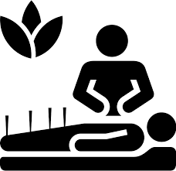
What is the alternative to going to the doctor in 2020?
Big business in 2020!
A range of reasons
Can you see how some ‘alternative’ or home remedies could remind you of ancient ones?
Have you ever had chamomile tea, lavender oil, ginger, honey and lemon?

Slide 12
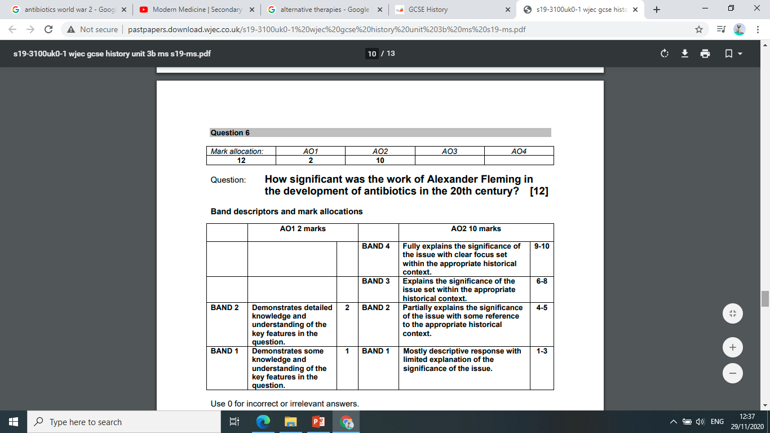
2019 exam question – 12 marks
How significant was the work of Alexander Fleming in the development of antibiotics in the 20th century?
The indicative content is on the next page…

Slide 13
Indicative content
This content is not prescriptive and candidates are not expected to refer to all the material
identified below. Some of the issues to consider are:
• Fleming’s discovery of penicillin was a significant medical breakthrough. It was the
first effective antibiotic. Cures for serious illnesses were now possible even if the
patient had the disease;
• Penicillin had been discovered during the 19th. century, but it was Fleming in 1928
who first realized its great importance. During WWI he realised that antiseptics could
not prevent all infection, especially in deep wounds. He decided to try to find
something that could kill the bacteria which caused infections like septicaemia;
• in 1928 Fleming noticed that bacteria he had grown were being killed by a mould -
penicillin. He used the word “antibiotic” to describe penicillin. However, Fleming did
not have the money or facilities to continue his research;
• in the 1930s Ernst Chain and Howard Florey, continued the work. In 1939, with the
start of war, they were given extra government funding. The problem was in
producing enough penicillin. In 1941 they tested it on a human and, though he died
when the penicillin ran out, it was obvious that it was effective;
• in 1941 the USA entered the war and the American government gave $80,000,000 to
research. By 1943 penicillin was being mass produced. In 1945 it was estimated that
the US army was giving two million doses per month. In the 1940s and 1950s other
antibiotics followed penicillin;
• Fleming was significant because he made the initial discovery, though it was left to
others (Florey and Chain) to test it on humans and the USA to mass produce it.
This is indicative content. It is produced as part of the mark scheme by the wjec. All papers and schemes can be found on www.wjec.co.uk

Slide 14


How significant was the work of Alexander Fleming in the development of antibiotics in the 20th century?
Paragraph 1 | What did Alexander Fleming discover? What had he being studying and why? What difference would an antibiotic have made?
Paragraph 2 | Explain how Florey and Chain developed Fleming’s ideas. Explain the significance of the use of antibiotics during WWII
Paragraph 3 | Reflect on the question… ‘how significant?’ Mention the Nobel prize. Consider Fleming’s contribution as part of the ‘big picture’ of antibiotic development. MAKE A JUDGEMENT!
YOU DO NOT HAVE TO USE THE FRAME BUT YOU DO NEED TO LIMIT YOUR TIME TO 12 MINUTES!

Slide 15
Key question: How have attempts to treat illness and disease changed over time?
This question usually appears as the final, 16 mark answer in the exam.
I suggest you plan for this by organizing your information in manageable chunks.
This will help you to plan and complete an essay answer which deals effectively with change and continuity.
Welsh examples are very important!

Slide 16
Key question: How have attempts to treat illness and disease changed over time?
The ongoing practice of… shows continuity because…
However, there were some elements of change in this area such as…
The use of ….shows change because…
This was a significant turning point because…
The pace of change accelerated at this point because…
Medieval times
Early Modern
Renaissance
Industrial Revolution
The 20th century
Victorian
19th century
The modern world
Useful words and phrases

Slide 17
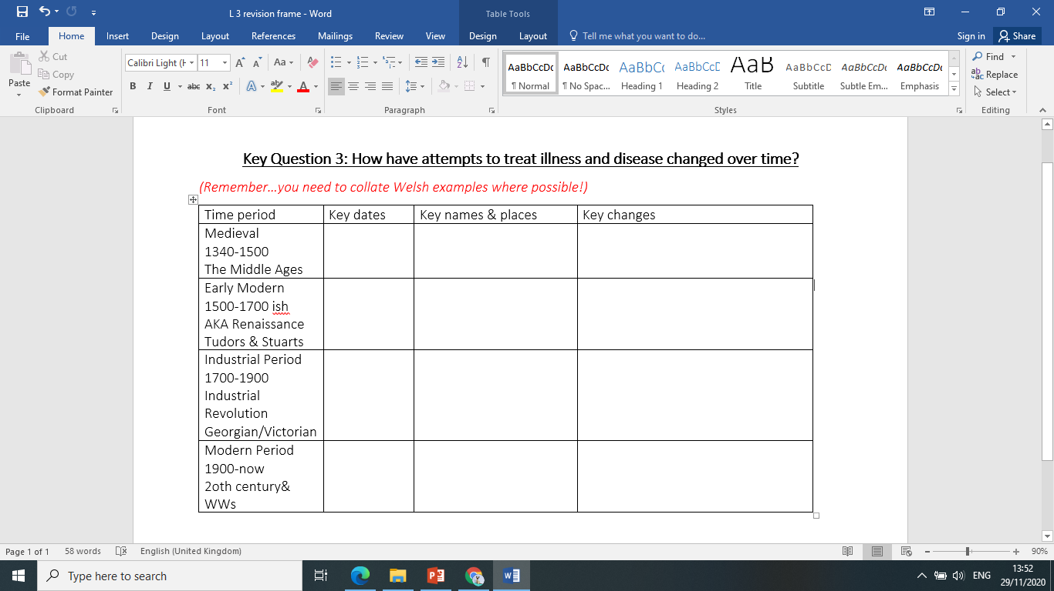
Follow on work:
Download the key question 3 table.
Fill it in.
Use that to answer the key question.
Make sure to use the language of change and continuity.
Look at the model provided (for key question 1)
Remember, you can use the chronology to help you to structure your answer but you do not have to adopt this model.

Slide 18
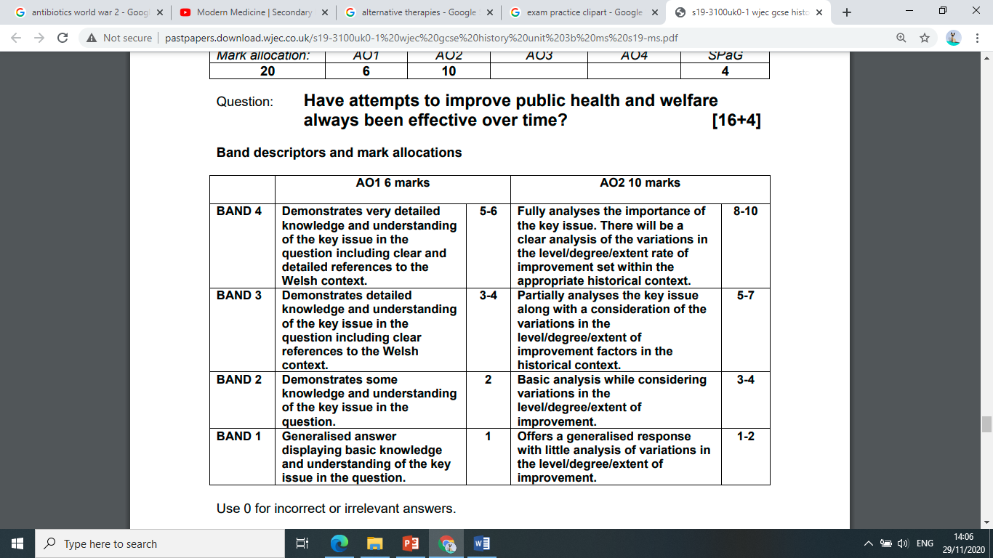
How have attempts to treat illness and disease changed over time?
This question requires candidates to draw upon the Welsh context in their responses. This is assessed in AO1 and candidates who do not draw upon the Welsh context cannot be awarded band 3 or band 4 marks for this assessment objective. Candidates who do not draw upon the Welsh context may, however, be awarded band 3 or band 4 marks for AO2, for an appropriately detailed analysis of the key issue.
16 marks
Plus 4 SPAG

Slide 19
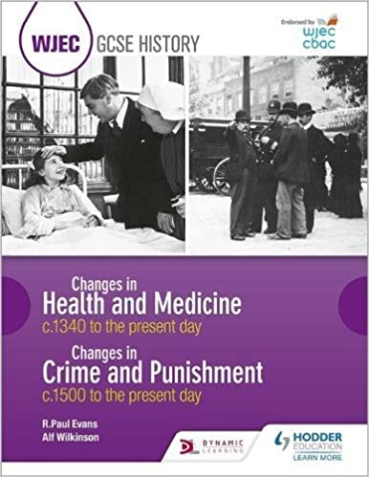
Further notes…
BBC bite size
https://www.bbc.co.uk/bitesize/guides/zwkm97h/revision/1
Don’t forget to hand in your exam questions for marking to your teacher!
The next step would be to reflect on the key question and complete a draft answer.

