Slide 1


How did people in the 19th century attempt to treat and cure illness and disease?
This is lesson 2 and is developing key question 3 from ‘Changes in Health and Medicine’ – Unit 3 – WJEC GCSE
This lesson will take 1 hour.
Bring a paper or notebook and a pen.
You will need to STOP and do some timed activities during the lesson.

Slide 2

Test your knowledge
DO THIS NOW….PAUSE THE VIDEO
Write down the answer to each of the following questions. Answers are on the next slide.
How did the church help in the treatment of illness in medieval times?
List 4 jobs a barber surgeon might have done.
How might a physician or barber surgeon have used urine?
What did the Dynion Hysbys do?
How did ‘holy wells’ work?
Give an example of a curative well in Wales.

Slide 3

Test your knowledge
Correct your answers… were your reasons accurate? Do you need to look back over previous lessons?
How did the church help in the treatment of illness in medieval times?
List 4 jobs a barber surgeon might do.
How might a physician or barber surgeon use urine?
What did the Dynion Hysbys do?
How did ‘holy wells’ work?
Give an example of a curative well in Wales.
Monasteries had infirmaries. Some monks had knowledge of herbal treatments. People went to wells, prayed to saints and went on pilgrimages.
Cut hair, pull teeth, amputate a limb, blood-letting, enema.
Study the colour, sniff it, taste it.
Broke witch spells.
Drinking or bathing in the water would cure you.
St Winifred’s Well.

Slide 4
During this lesson, we will…
Describe the development of anaesthetics.
Question the effectiveness of anaesthetics in the treatment of illness in the 19th century.
Consider the importance of antiseptics at the point of discovery and in 2020.
We will finish this lesson with 2 exam questions.

Slide 5
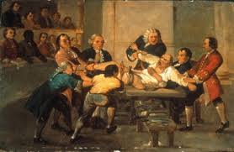
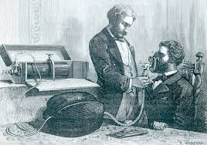
Describe the development and use of anaesthetics in the 19th century.
Surgery meant pain
Patients were restrained
Given alcohol or opium
Many died of shock
Nitrous oxide/laughing gas
Sir Humphrey Davy
Quick pain relief but too unstable for major surgery

Slide 6
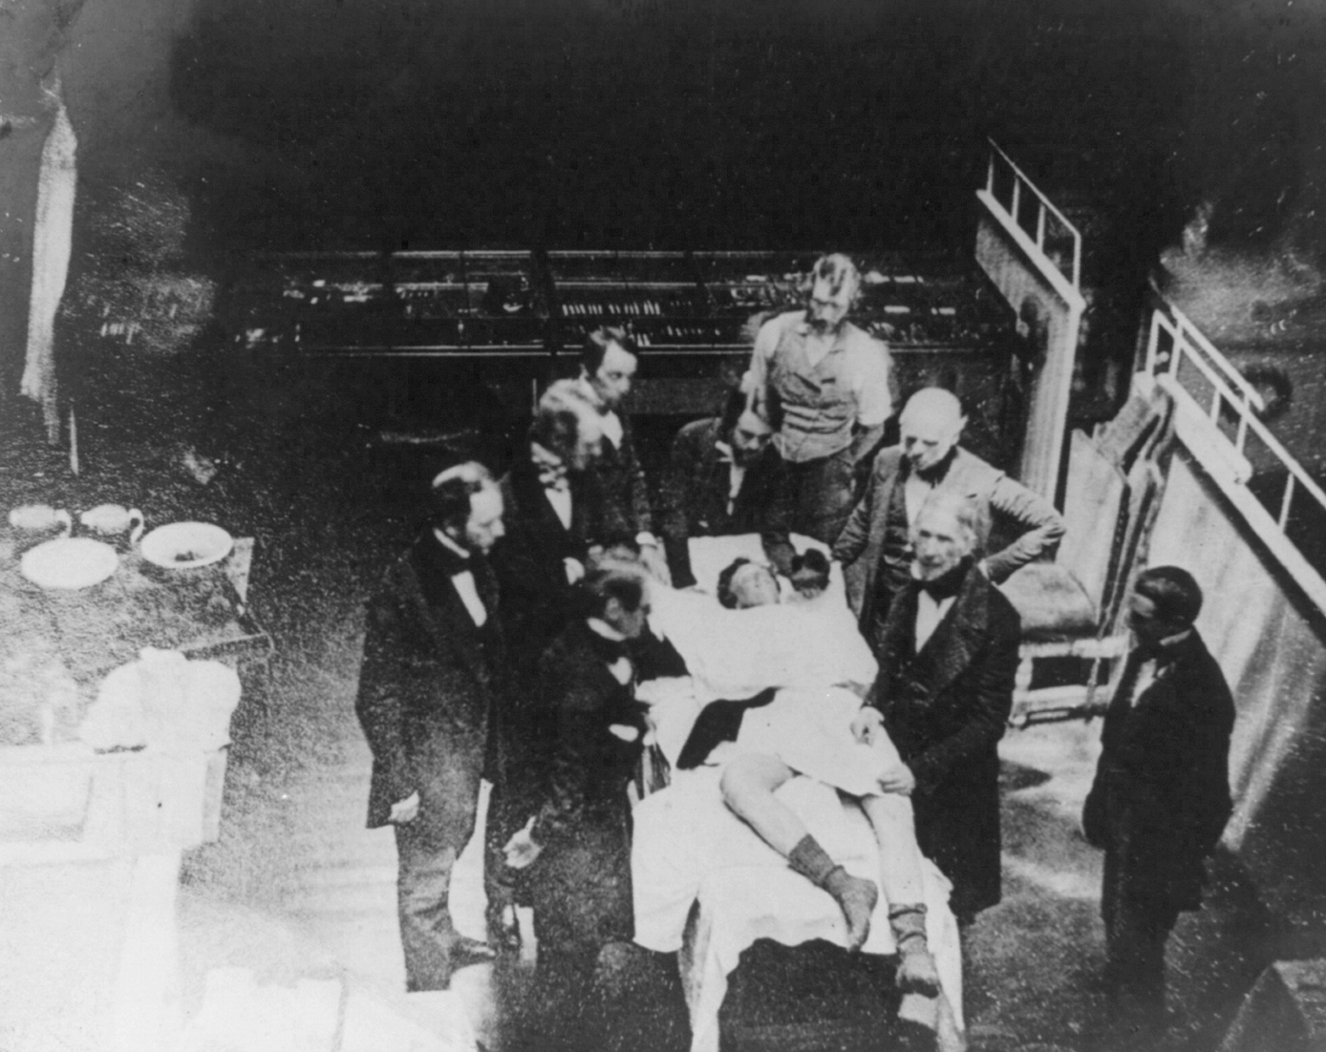
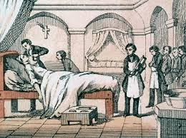
Describe the development and use of anaesthetics in the 19th century?
Ether
1846 Robert Liston
Amputated limbs
Patients sometimes woke up…horror!
Chloroform
1847 James Simpson started to use chloroform in childbirth
1853 Queen Victoria used it!
Getting the quantity right was vital.

Slide 7
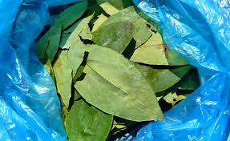
Describe the development and use of anaesthetics in the 19th century?
Coca leaves
The leaves produced cocaine which when administered, numbed the area.
A local anaesthetic
Useful but addictive
Note:
A pain free surgery experience could be achieved by the late 1800s. However, surgeons could easily make a mistake with the doses…
More importantly, having a pain free operation did not guarantee you freedom from infection.

Slide 8

Clip: Lister and Simpson
https://www.youtube.com/watch?v=Vg1hqZanDa0
Watch this clip from BBC Teach for 4 minutes 50 seconds.
Make notes and stop the video when you need to.

Slide 9

How important were antiseptics to surgery in the 19th century?
We all now know that we need to wash our hands to stay healthy!
Ignaz Semmelweis proved that if doctors washed their hands fewer mothers and babies would die. He was ignored!
Ignaz Semmelweis first told the world in 1847 that he could reduce deaths from 35% to less than 1%
He worked in a maternity ward in Vienna.

Slide 10
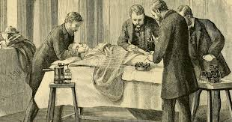
The ‘Father of Antiseptic Surgery’
Joseph Lister used an operating room sterilized with carbolic acid.
His surgical instruments were sterilized with carbolic acid.
Mortality rates reduced from 46% to 15% in 3 years.
1871 – Lister invented a machine to spray carbolic acid

Slide 11
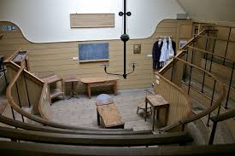

Further developments: aseptic surgery
1881 Charles Chamberland invented a steam sterilizer
1886 Gustav Neubar, a German surgeon developed the first sterile operating theatre.
Things move much more quickly towards the end of the 1800s. This is mostly because of the development of germ theory and the acceptance that germs caused disease!

Slide 12
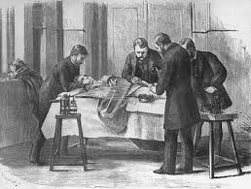
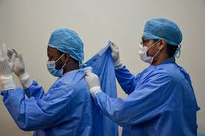
Surgical clothing or in 2020, PPE!
It took many years before surgeons realized that they needed to dress differently for surgery.
In 2020 we are now very aware of the need for personal protective equipment or PPE.
It is very important that surgery spaces are kept sterile.

Slide 13

Complete the following 2 exam questions.
1. How effective was the development and use of anaesthetics as a method of treating and curing illness in the 19th century?
12 marks
2. Explain why the development of antiseptics in the late 1800s was important to the treatment of illness?
12 marks
Optional writing frame on the next page…

Slide 14
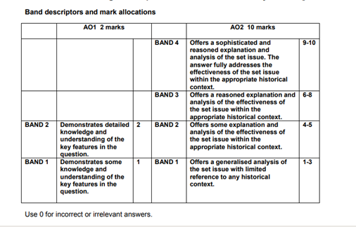
How effective was the development and use of anaesthetics as a method of treating and curing illness in the 19th century?
Provide background detail and context
Mention how anaesthetics developed but please make sure to use detail (dates & names) which you may have recorded from the clip, the ppt or the bitesize link on the last page of this ppt.
Use the appropriate context.
Be sure to fully concentrate on effectiveness.
Judge it!

Slide 15
How effective was the development and use of anaesthetics as a method of treating and curing illness in the 19th century?
Paragraph 1:
The development of anaesthetics was a turning point in the history of medicine.
Explain how and why anaesthetics are used in surgery.
Middle section:
Weigh up the effectiveness of each development (strengths and weaknesses).
Mention: alcohol/opium, laughing gas, chloroform, ether, cocaine.
For example, you could say ‘chloroform was used by James Simpson in the mid 1800s and this proved effective in killing pain during childbirth. However, chloroform made some women and babies sick so many people would not use it.’
Conclusion:
Come to a conclusion and reach a judgement. Link clearly back to the question.
For example: the use of anaesthetics clearly developed during the 19th century and by the end of the century pain could be avoided. However…. [did everyone accept it? What about antiseptics?]
This is only a suggestion. The important thing is that you include a range of factors, examples AND explanations.

Slide 16
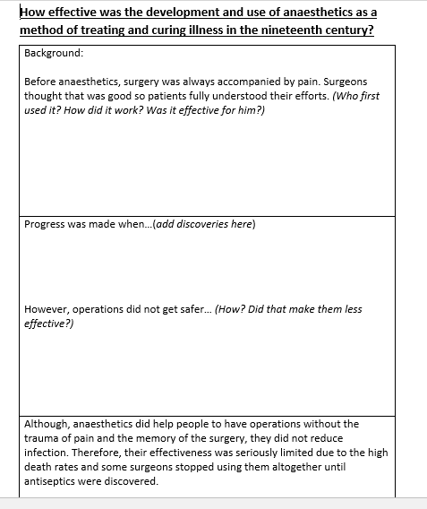
This is another way to do the same answer.
If you need to, print this out or download and use.
A word document will be attached.

Slide 17
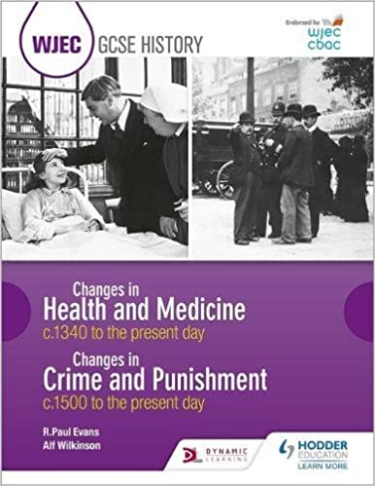
Further notes…
BBC bite size
https://www.bbc.co.uk/bitesize/guides/zwkm97h/revision/1
Don’t forget to hand in your exam questions for marking to your teacher!
The next lesson will deal with attempts to treat and cure illness in the 1900s.

